Slide 1
ER- and EER-to-Relational Mapping

Slide 2
ER-to-Relational Mapping Algorithm
  Step 1: Mapping of Regular Entity Types
  Step 2: Mapping of Weak Entity Types
  Step 3: Mapping of Binary 1:1 Relation Types
  Step 4: Mapping of Binary 1:N Relationship Types.
  Step 5: Mapping of Binary M:N Relationship Types.
  Step 6: Mapping of Multivalued attributes.
  Step 7: Mapping of N-ary Relationship Types.
Mapping EER Model Constructs to Relations
  Step 8: Options for Mapping Specialization or Generalization.
  Step 9: Mapping of Union Types (Categories).

Slide 3
Step 1: Mapping of Regular Entity Types
Step 1: Mapping of Regular Entity Types.
  For each regular (strong) entity type E in the ER schema, create a relation R that includes all the simple attributes of E.
  Choose one of the key attributes of E as the primary key for R.
  All simple attributes will become column in the table
  If the chosen key of E is composite, the set of simple attributes that form it will together form the primary key of R.
  Derived attribute will not become part of the table

Slide 4

ER DIAGRAM

Slide 5
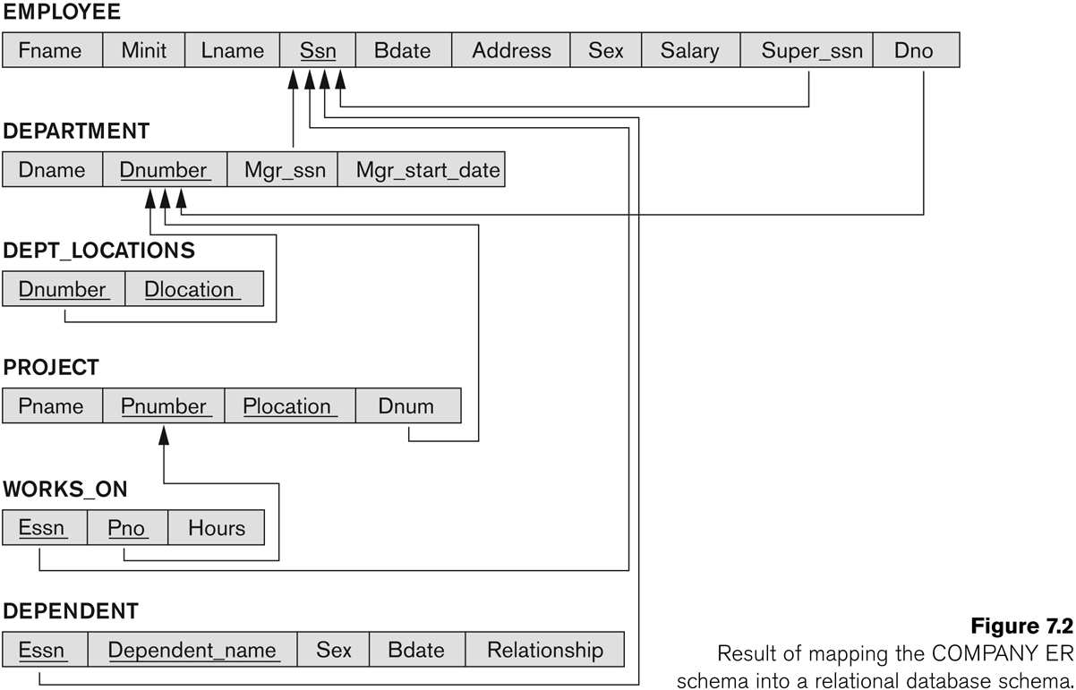
Result of mapping the COMPANY ER schema into a relational schema.

Slide 6
Step 1: Mapping of Regular Entity Types
Example: We create the relations EMPLOYEE, DEPARTMENT, and PROJECT in the relational schema corresponding to the regular entities in the ER diagram.
  SSN, DNUMBER, and PNUMBER are the primary keys for the relations EMPLOYEE, DEPARTMENT, and PROJECT as shown.

Slide 7
Step 2: Mapping of Weak Entity Types
  For each weak entity type W in the ER schema with owner entity type E, create a relation R & include all simple attributes (or simple components of composite attributes) of W as attributes of R.
  Also, include as foreign key attributes of R the primary key attribute(s) of the relation(s) that correspond to the owner entity type(s).
  The primary key of R is the combination of the primary key(s) of the owner(s) and the partial key of the weak entity type W, if any.

Slide 8
Step 2: Mapping of Weak Entity Types
Example: Create the relation DEPENDENT in this step to correspond to the weak entity type DEPENDENT.
  Include the primary key SSN of the EMPLOYEE relation as a foreign key attribute of DEPENDENT (renamed to ESSN).
  The primary key of the DEPENDENT relation is the combination {ESSN, DEPENDENT_NAME} because DEPENDENT_NAME is the partial key of DEPENDENT

Slide 9
Step 3: Mapping of Binary 1:1 Relation Types
  For each binary 1:1 relationship type R in the ER schema, identify the relations S and T that correspond to the entity types participating in R.

Slide 10
Step 3: Mapping of Binary 1:1 Relation Types
  Foreign Key approach: Choose one of the relations-say S-and include a foreign key in S the primary key of T. It is better to choose an entity type with total participation in R in the role of S.
    Example: 1:1 relation MANAGES is mapped by choosing the participating entity type DEPARTMENT to serve in the role of S, because its participation in the MANAGES relationship type is total.

Slide 11
ER DIAGRAM

Slide 12
FIGURE Result of mapping the COMPANY ER schema into a relational schema.

Slide 13
Step 4: Mapping of Binary 1:N Relationship Types
  For each regular binary 1:N relationship type R, identify the relation S that represent the participating entity type at the N-side of the relationship type.
  Include as foreign key in S the primary key of the relation T that represents the other entity type participating in R.
  Include any simple attributes of the 1:N relation type as attributes of S.

Slide 14
Step 4: Mapping of Binary 1:N Relationship Types
Example: 1:N relationship types WORKS_FOR, CONTROLS, and SUPERVISION in the figure.
  For WORKS_FOR we include the primary key DNUMBER of the DEPARTMENT relation as foreign key in the EMPLOYEE relation and call it DNO.

Slide 15
Step 5: Mapping of Binary M:N Relationship Types
  For each regular binary M:N relationship type R, create a new relation S to represent R.
  Include as foreign key attributes in S the primary keys of the relations that represent the participating entity types; their combination will form the primary key of S.
  Also include any simple attributes of the M:N relationship type (or simple components of composite attributes) as attributes of S.

Slide 16
Step 5: Mapping of Binary M:N Relationship Types
Example: The M:N relationship type WORKS_ON from the ER diagram is mapped by creating a relation WORKS_ON in the relational database schema.
  The primary keys of the PROJECT and EMPLOYEE relations are included as foreign keys in WORKS_ON and renamed PNO and ESSN, respectively.
  Attribute HOURS in WORKS_ON represents the HOURS attribute of the relation type. The primary key of the WORKS_ON relation is the combination of the foreign key attributes {ESSN, PNO}.

Slide 17
Step 6: Mapping of Multivalued attributes
  For each multivalued attribute A, create a new relation R.
  This relation R will include an attribute corresponding to A, plus the primary key attribute K-as a foreign key in R-of the relation that represents the entity type of relationship type that has A as an attribute.
  The primary key of R is the combination of A and K. If the multivalued attribute is composite, we include its simple components.

Slide 18

Step 6: Mapping of Multivalued attributes
Example: The relation DEPT_LOCATIONS is created.
  The attribute DLOCATION represents the multivalued attribute LOCATIONS of DEPARTMENT, while DNUMBER-as foreign key-represents the primary key of the DEPARTMENT relation.
  The primary key of R is the combination of {DNUMBER, DLOCATION}.

Slide 19
Step 7: Mapping of N-ary Relationship Types
  For each n-ary relationship type R, where n>2, create a new relationship S to represent R.
  Include as foreign key attributes in S the primary keys of the relations that represent the participating entity types.
  Also include any simple attributes of the n-ary relationship type (or simple components of composite attributes) as attributes of S.

Slide 20
Step 7: Mapping of N-ary Relationship Types
Example: The relationship type SUPPY in the ER on the next slide.
  This can be mapped to the relation SUPPLY shown in the relational schema, whose primary key is the combination of the three foreign keys {SNAME, PARTNO, PROJNAME}

Slide 21

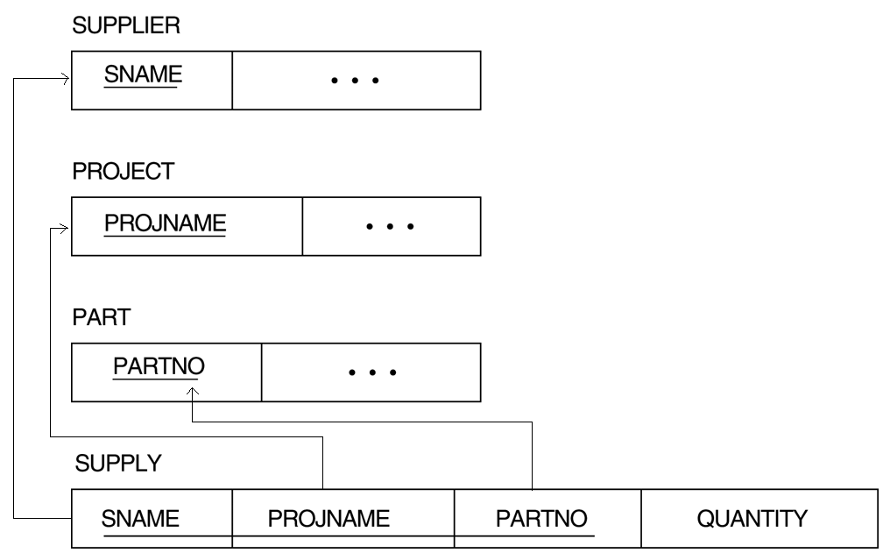
Step 7: Mapping of N-ary Relationship Types

Slide 22
Summary of Mapping constructs and constraints
Correspondence between ER and Relational Models
ER Model Relational Model
Entity type “Entity” relation
1:1 or 1:N relationship type Foreign key (or “relationship” relation)
M:N relationship type “Relationship” relation and two foreign keys
n-ary relationship type “Relationship” relation and n foreign keys
Simple attribute Attribute
Composite attribute Set of simple component attributes
Multivalued attribute Relation and foreign key
Value set Domain
Key attribute Primary (or secondary) key

Slide 23
Mapping EER Model Constructs to Relations
  Step 8: Options for Mapping Specialization or Generalization.

Slide 24
Step8: Options for Mapping Specialization or Generalization
    Option 8A: Multiple relations-Superclass and subclasses
    Option 8B: Multiple relations-Subclass relations only
    Option 8C: Single relation with one type attribute
    Option 8D: Single relation with multiple type attributes

Slide 25

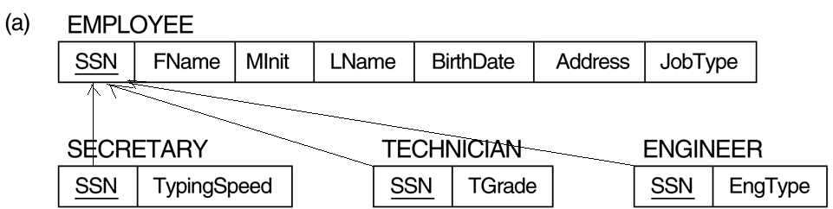
Option 8A: Multiple relations-Superclass and subclasses

Slide 26
Step8: Options for Mapping Specialization or Generalization
Option 8A: Multiple relations-Superclass and subclasses
  Create a relation L for C with attributes Attrs(L) = {k,a1,…an} and PK(L) = k. Create a relation Li for each subclass Si, 1 < i < m, with the attributesAttrs(Li) = {k} U {attributes of Si} and PK(Li)=k. This option works for any specialization (total or partial, disjoint or over-lapping).

Slide 27
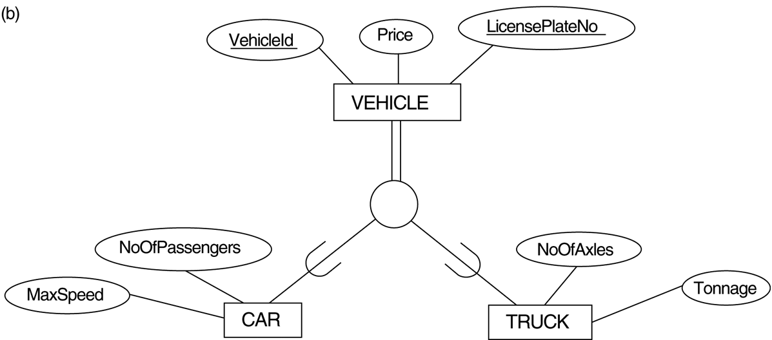
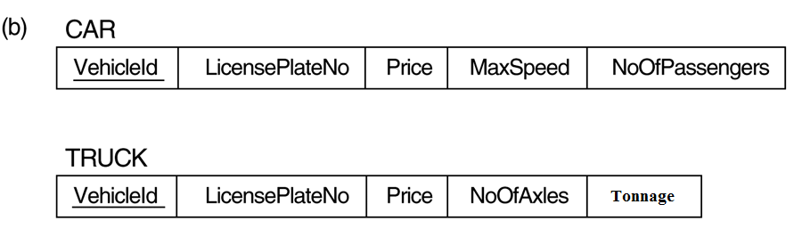
Option 8B: Multiple relations-Subclass relations only

Slide 28
Step8: Options for Mapping Specialization or Generalization
Option 8B: Multiple relations-Subclass relations only
  Create a relation Li for each subclass Si, 1 < i < m, with the attributes Attr(Li) = {attributes of Si} U {k,a1…,an} and PK(Li) = k. This option only works for a specialization whose subclasses are total (every entity in the superclass must belong to (at least) one of the subclasses.

Slide 29

Option 8C: Single relation with one type attribute

Slide 30
Step8: Options for Mapping Specialization or Generalization
Option 8C: Single relation with one type attribute
  Create a single relation L with attributes Attrs(L) = {k,a₁,…a_{n}} U {attributes of S₁} U…U {attributes of S_{m}} U {t} and PK(L) = k. The attribute t is called a type (or discriminating) attribute that indicates the subclass to which each tuple belongs

Slide 31

Option 8D: Single relation with multiple type attributes

Slide 32
Step8: Options for Mapping Specialization or Generalization
Option 8D: Single relation with multiple type attributes
  Create a single relation schema L with attributes Attrs(L) = {k,a₁,…a_{n}} U {attributes of S₁} U…U {attributes of S_{m}} U {t₁, t₂,…,t_{m}} and PK(L) = k. Each t_{i}, 1 < I < m, is a Boolean type attribute indicating whether a tuple belongs to the subclass S_{i}.

